Slide 1
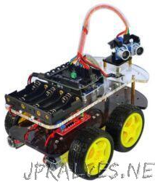
ROBOTIC CAR CONTROL USING ANDROID APPLICATION
Amrutvahini College of Engineering, Sangamner
Submitted by
1) Mr. PRANAV AMBRE
2) Mr. SHUBHAN BHADKE
3) Mr. ABHISHEK GADE
4) Ms. SMITA MANDLIK
Guided by
Prof. R. N. DEOKAR
2022-23
Amrutvahini College of Engineering, Sangamner

Slide 2
Problem Statement
Every year, approximately 1.5 lakh people dies on India roads, which translate, on an average, into 1130 accidents and 422 deaths every day or 47 accidents and 18 deaths every hour.
Current remotecontrolled cars do not have obstacle detection capabilities, posing a safety risk.
Existing remotecontrolled cars lack alcohol sensing capabilities, which can be essential for certain applications.
The motor control system should be integrated to provide precise control over the robotic car's movements.

Slide 3
Introduction of Project
The Android controlled robot car combines modern technology and robotics, providing a userfriendly interface through an Android device.
The integration of Android technology with robotics takes remotecontrolled vehicles to a whole new level of accessibility and userfriendliness.
Extensive research and development were conducted to optimize wireless communication and control protocols, ensuring realtime control and feedback.
Additional sensors, such as obstacle detection and avoidance systems, were integrated to enhance the robot car's functionality and enable autonomous navigation.
The project represents a fusion of mobile computing, wireless communication, and robotics, pushing the boundaries of innovation in the field of autonomous vehicles.
The rapid development of smartphone technology and wireless communication provides a platform for applying control theory to the car, improving road safety and driving capabilities.
The project aims to integrate aspects of human intelligence and behaviors into the robot car's driving actuators, making it capable of managing driving tasks similar to humans.

Slide 4
Need of Project
Safety and Risk Mitigation: The project addresses the need for a robotic car that can operate in hazardous environments, reducing the risk to human lives.
Efficiency and Time Savings: The robotic car offers a more efficient solution for repetitive or timeconsuming tasks, freeing up human resources for more critical activities.
Accessibility and Inclusivity: By integrating Android technology, the project makes controlling the robotic car accessible to a wide range of users, regardless of their technical expertise.
Surveillance and Security: The robotic car enhances surveillance capabilities, contributing to public safety and crime prevention.
Exploration and Research: The project enables the exploration of inaccessible or hazardous environments, providing valuable data for scientific research and exploration missions.

Slide 5
Aim of Project
Design and develop a robotic car: Create a platform for a robotic car that can perform various movements and navigate its surroundings.
1
Integration of modern technology: Incorporate Android technology, wireless communication, and robotics to enable remote control of the car using an Android device.
2
Userfriendly interface: Develop a custom Android application that provides a userfriendly interface for controlling the robotic car. The interface should be intuitive and easy to use.
3
Enhanced functionality: Explore the integration of additional sensors and features to enhance the functionality of the robotic car. This may include obstacle detection and avoidance systems, video streaming capabilities, and autonomous navigation.

Slide 6
Objectives
Design and develop
Design and develop a robotic car controlled by an Android device.
Establish
Establish a reliable and responsive wireless communication between the Android device and the robotic car.
Implement
Implement intuitive controls and a userfriendly interface in the Android application for easy maneuvering of the robotic car.
Incorporate
Incorporate sensors for obstacle detection and avoidance to ensure safe navigation.
Optimize
Optimize the control algorithms and hardware components for efficient and seamless integration.

Slide 7
Components of Project
ESP8266 WIFI Module
Arduino Uno R3
L293D Motor Driver Module
Ultrasonic Sensor
Alcohol Sensor (Gas Sensor )
Jumper wire
9 V Battery

Slide 8
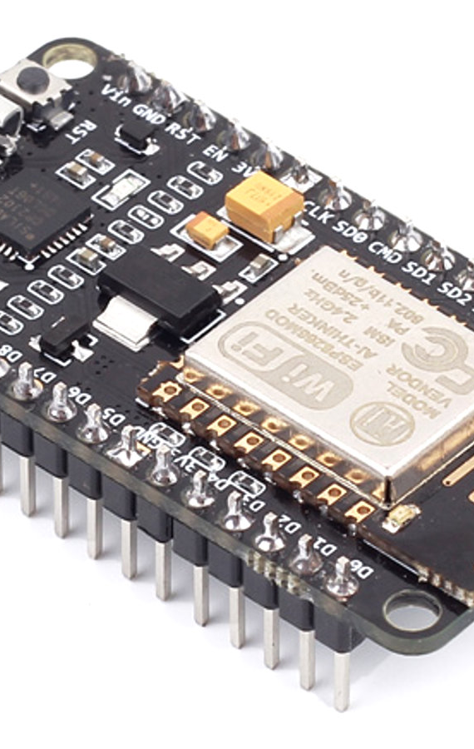
ESP8266 WIFI Module
Number of GPIO (General Purpose Input/Output) pins: The ESP8266 module typically has 11 GPIO pins, which can be used for both input and output operations.
Power handling capacity: The ESP8266 module operates on a supply voltage of 3.3 volts. It is important to note that the module is not 5V tolerant, and using a voltage higher than 3.3 volts can damage the module.
Current requirements: The ESP8266 module has varying current requirements depending on its operating mode and usage. In general, it can consume around 70-170 mA during active WiFi transmission and reception, and around 20-40 mA during normal operation.
Communication interface: The ESP8266 module supports UART (Universal Asynchronous Receiver-Transmitter) communication, allowing it to communicate with microcontrollers like Arduino through serial communication.
WiFi capabilities: The ESP8266 module is specifically designed for WiFi connectivity. It supports 802.11 b/g/n standards and can function as a WiFi client or a WiFi access point, allowing devices to connect to it or connect to an existing WiFi network.

Slide 9
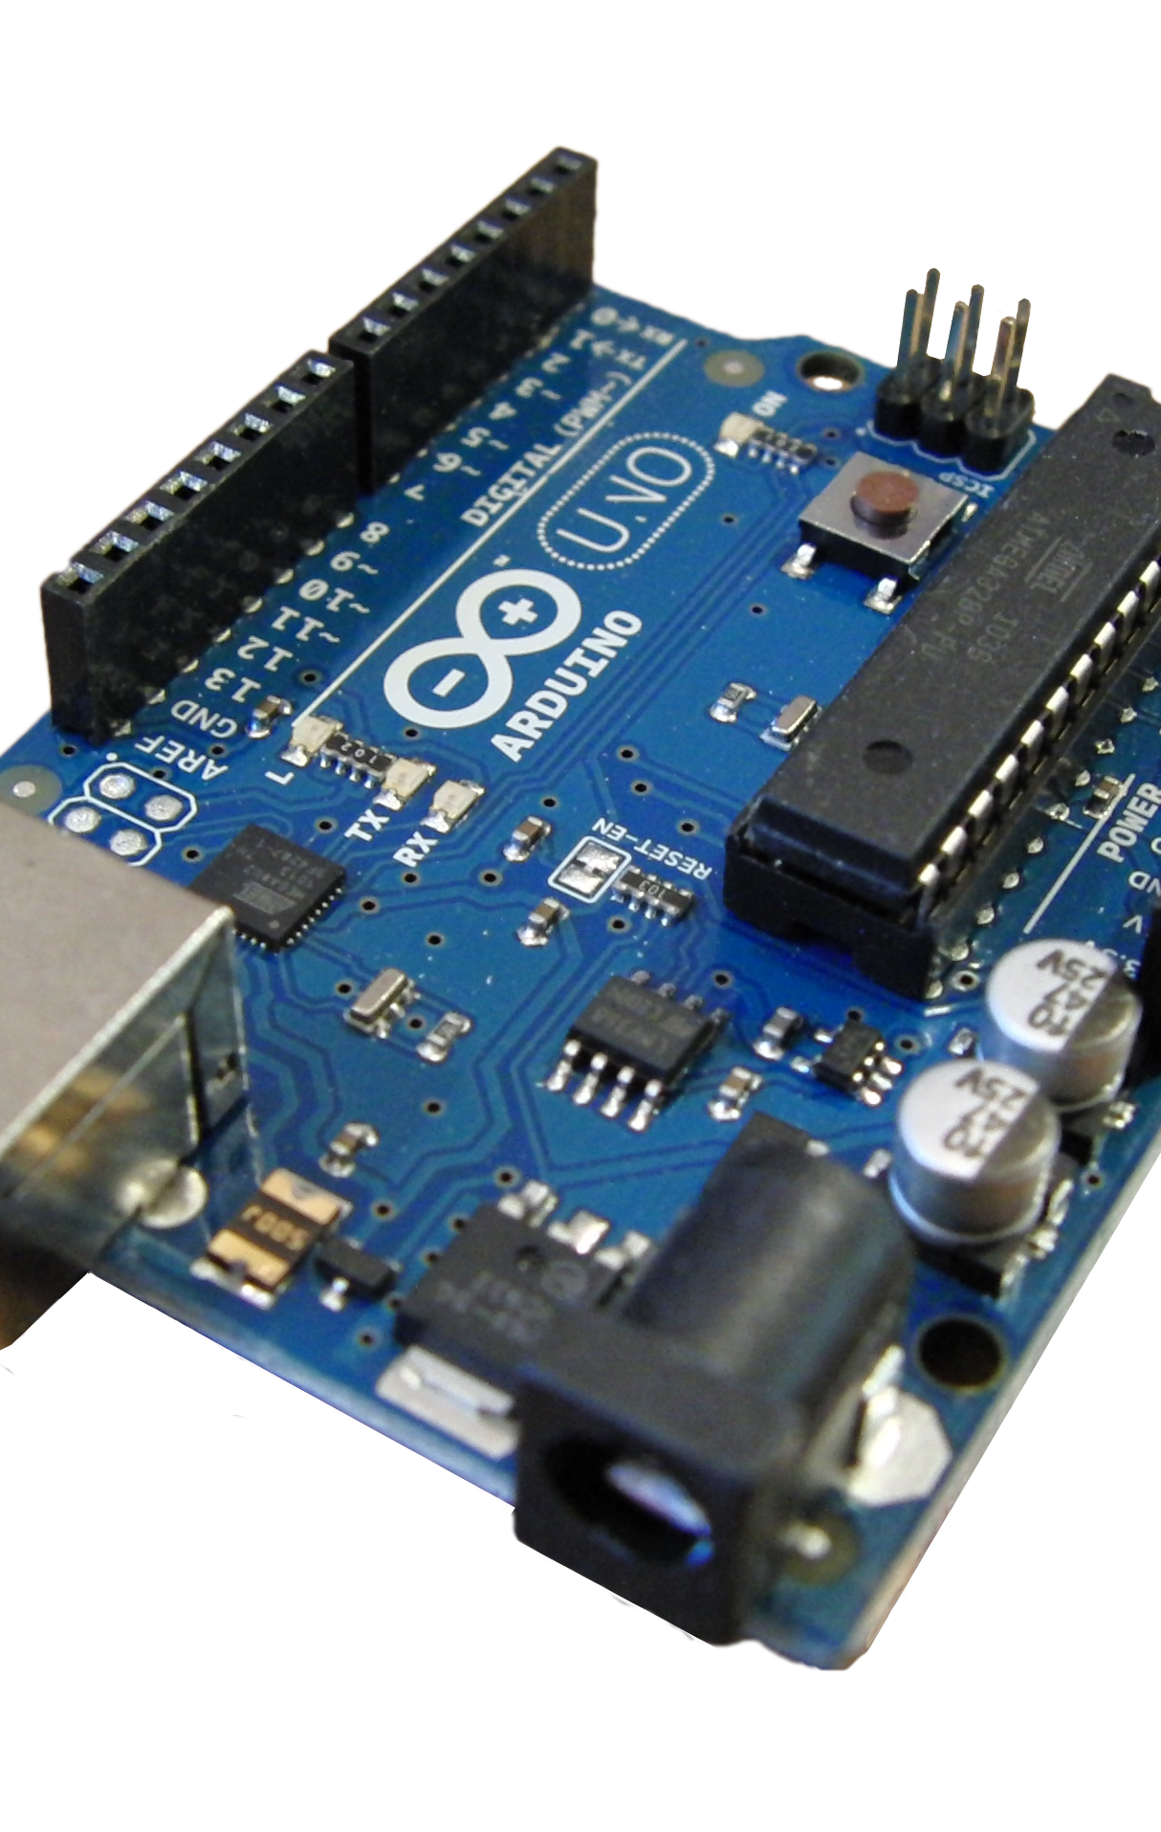
Arduino Uno R3
Number of digital input/output pins: 14
Number of analog input pins: 6
Power handling capacity: The Arduino Uno R3 can be powered through USB or an external power source. It can handle a voltage range of 6 to 20 volts.
Current requirements: The board operates on a supply voltage of 5 volts. The recommended input current is 7-12 mA for 3.3V pins and 20 mA for 5V pins.
Output pins: The digital output pins can provide a maximum of 40 mA current each.
Analog pins: The Arduino Uno R3 has 6 analog input pins labeled A0 to A5, which can measure analog voltages in the range of 0 to 5 volts.

Slide 10
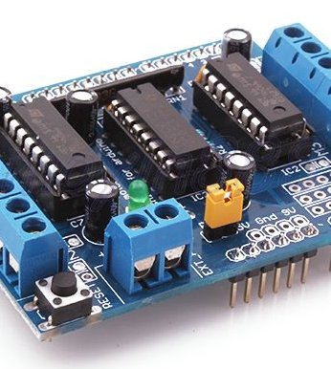
L293D Motor Driver Module
Purpose: The L293D Motor Driver Module is designed to control the direction and speed of DC motors or stepper motors. It acts as a bridge between the microcontroller (such as Arduino) and the motors, providing the necessary current and voltage levels for motor operation.
Motor control: The L293D module can control two motors independently or a single motor with dual functionality (forward and reverse). It allows you to control the motor's direction (clockwise or counterclockwise) and adjust the speed using Pulse Width Modulation (PWM) signals.
Power handling capacity: The L293D module can handle a maximum motor supply voltage of up to 36V and a maximum continuous current of around 600mA per motor (with peak current up to 1.2A). However, the actual power handling capacity may vary depending on the specific module variant and the heat dissipation capability.
Output pins: The L293D module typically has four output pins (two for each motor) labeled as OUT1, OUT2, OUT3, and OUT4. These pins are connected to the motor terminals and allow the module to control the motor's direction and speed.
Control interface: The L293D module can be controlled using digital signals from a microcontroller. It requires at least four control pins (IN1, IN2, IN3, and IN4) to set the motor direction and additional pins (such as Enable pins) to control motor speed.

Slide 11
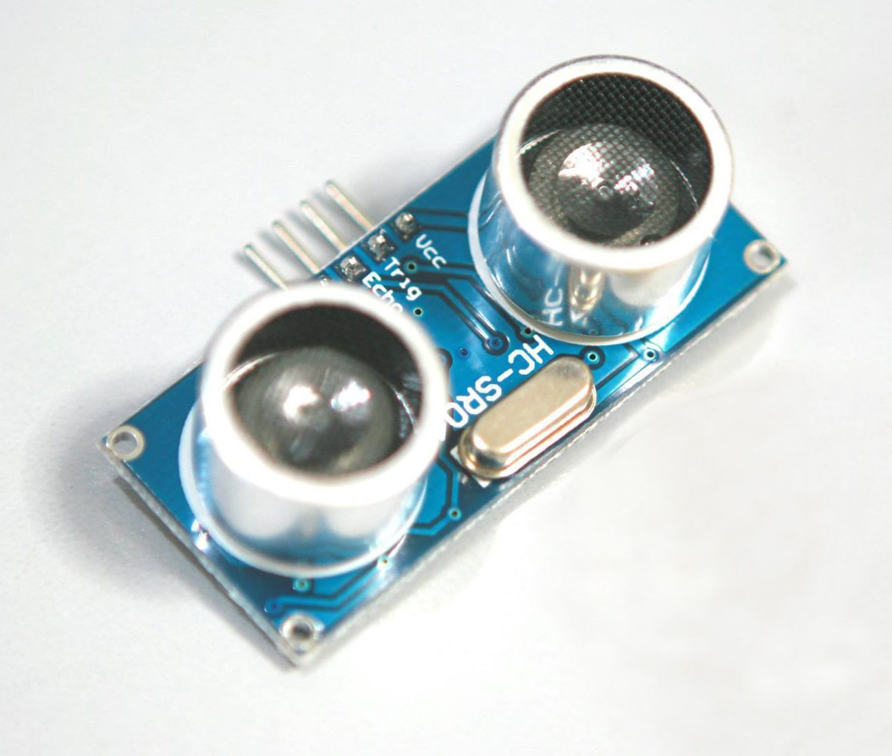
Ultrasonic Sensor
Range: Ultrasonic Sensors are commonly available with different range options, such as 2 meters, 3 meters, or even higher. The range indicates the maximum distance the sensor can detect objects accurately.
Power Requirements: Ultrasonic Sensors typically require a power supply voltage in the range of 5V to 12V. The specific voltage requirement may vary depending on the model and manufacturer of the sensor.
Current Consumption: The current consumption of Ultrasonic Sensors is relatively low, usually ranging from a few milliamperes (mA) to around 15-20mA during operation.
Working Principle: Ultrasonic Sensors work based on the principle of sound waves. They emit high-frequency sound waves (ultrasonic waves) and measure the time it takes for the sound waves to bounce back after hitting an object. By calculating the time taken and knowing the speed of sound, the sensor can determine the distance to the object.
Operating Mode: Ultrasonic Sensors typically operate in a pulse-echo mode. They emit a short burst of ultrasonic waves and then listen for the echo. The time between the emission and reception of the echo is used to calculate the distance to the object.
Accuracy: Ultrasonic Sensors provide reasonably accurate distance measurements, usually within a few millimeters to a few centimeters, depending on the sensor's specifications and the environmental conditions.
\

Slide 12
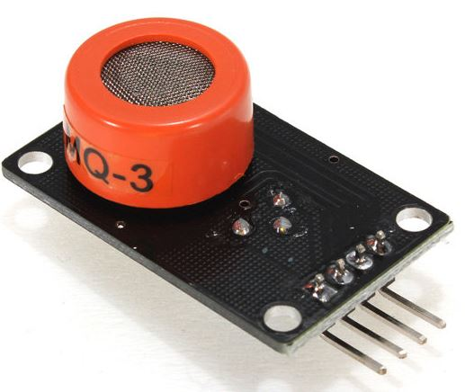
Alcohol Sensor (Gas Sensor)
Range: Alcohol sensors detect alcohol vapors in a range of several parts per million (ppm) to higher concentrations.
Power Requirements: Typically operate at a voltage of 3.3V to 5V.
Current Consumption: Low current consumption, usually ranging from a few mA to tens of mA.
Working Principle: Detect alcohol vapors through chemical reactions, conductivity changes, or catalytic oxidation.
Calibration: Requires calibration to ensure accurate readings by exposing the sensor to known alcohol concentrations.
Applications: Used in breathalyzer devices, automotive safety systems, industrial safety, and monitoring applications.

Slide 13
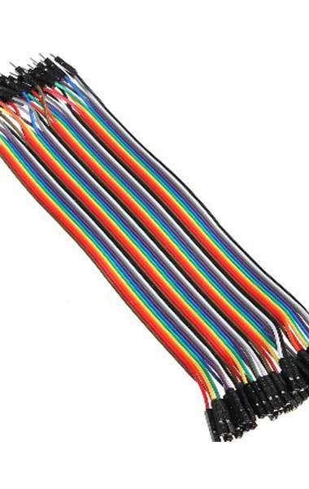
Jumper Wire
Function: Jumper wires are used to establish connections between different electronic components, such as microcontrollers, sensors, breadboards, and circuit boards.
Construction: Jumper wires are typically made of flexible insulated wire with metal pins or connectors at each end.
Length: Available in various lengths, such as 10cm, 20cm, or longer, to accommodate different circuit layouts and distances between components.
Colors: Jumper wires are often color-coded, such as red, black, yellow, blue, or green, to facilitate easy identification and organization of connections.
Types: There are different types of jumper wires, including male-to-male, male-to-female, and female-to-female, depending on the type of connectors needed for specific connections.
Flexibility: Jumper wires offer flexibility and ease of use, allowing for quick and temporary connections or prototyping without the need for soldering.
This Photo by Unknown author is licensed under CC BY-SA.

Slide 14
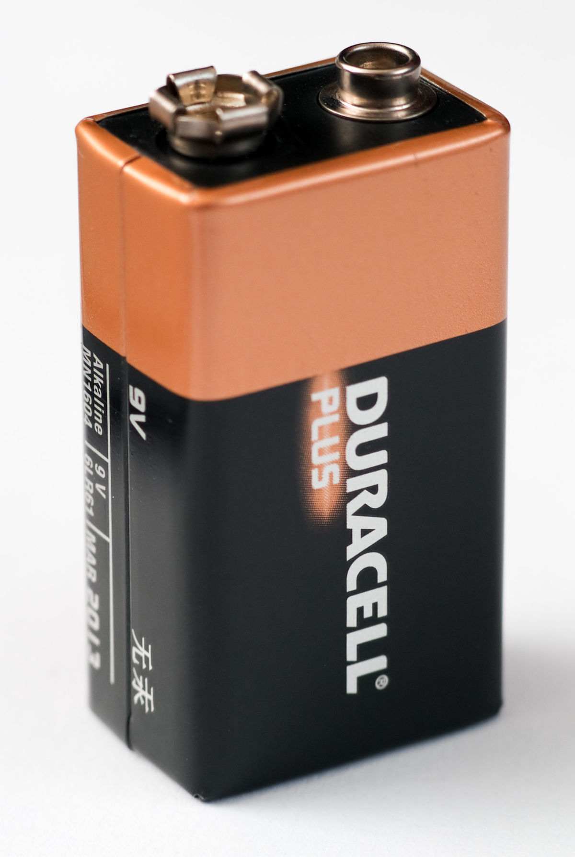
9 V Battery
Voltage: A 9V battery provides a nominal voltage of 9 volts, which is suitable for powering low to moderate power electronic devices.
Power Capacity: The power capacity of a 9V battery varies depending on the brand and type. It typically ranges from around 400mAh to 600mAh, providing a decent amount of energy for portable applications.
Connector: A 9V battery usually comes with a snap-on connector that allows easy connection to compatible devices or battery holders.
Usage: 9V batteries are commonly used in a wide range of electronic devices such as smoke detectors, remote controls, portable radios, electronic toys, and small electronic circuits.
Size and Form Factor: A 9V battery is rectangular in shape and relatively compact. It typically measures around 48.5mm x 26.5mm x 17.5mm (L x W x H).
Replacement and Rechargeability: 9V batteries are available in both disposable (non-rechargeable) and rechargeable versions. Rechargeable 9V batteries can be recharged multiple times, providing a more cost-effective and environmentally friendly option.
This Photo by Unknown author is licensed under CC BY-SA.

Slide 15
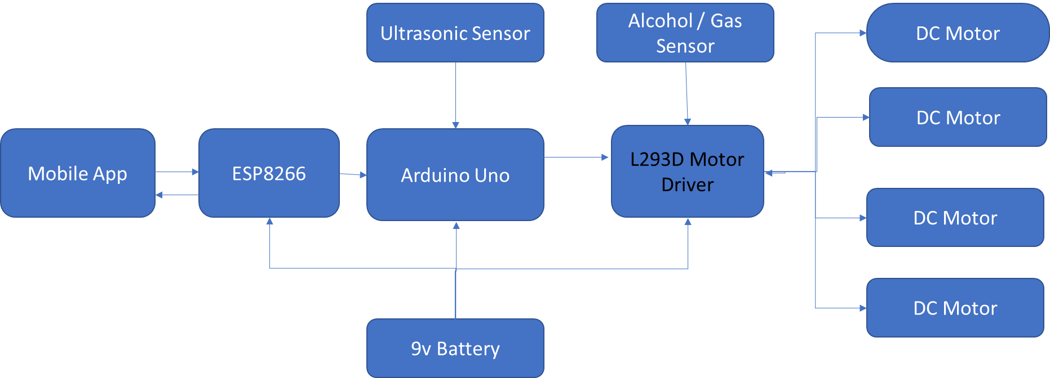
Block Diagram
Alcohol Sensor
LED

Slide 16
Working
Android Application: The project starts with the Android application installed on the user's smartphone or tablet. The application serves as the control interface for the robotic car, allowing the user to send commands and control the car's movements.
Wireless Communication: The Android application communicates with the robotic car wirelessly using a communication protocol such as Wi-Fi or Bluetooth. It establishes a connection with the car's microcontroller module (e.g., ESP8266) to send control signals.
Microcontroller Module: The microcontroller module (e.g., ESP8266) acts as the intermediary between the Android application and the robotic car's hardware components. It receives the control signals from the application and processes them to perform the desired actions.

Slide 17
Motor Control: The microcontroller module controls the robotic car's motors through a motor driver module (e.g., L293D). It sends appropriate signals to the motor driver module to control the speed and direction of the motors, enabling the car to move forward, backward, turn left, or turn right.
Sensor Integration: The robotic car is equipped with various sensors, such as ultrasonic sensors and alcohol sensors. These sensors provide input to the microcontroller module, allowing the car to detect obstacles and measure alcohol concentration in the environment.
Data Processing: The microcontroller module receives data from the sensors and performs necessary computations and logic to make decisions. For example, it uses the data from ultrasonic sensors to detect and avoid obstacles, ensuring safe navigation.
Real-time Feedback: The microcontroller module can provide real-time feedback to the Android application. For example, it can send sensor readings or status updates back to the application, allowing the user to monitor the car's surroundings or receive notifications.
User Control: The Android application continuously receives user input and sends corresponding commands to the microcontroller module. The user can control the car's movements, activate sensors, or perform other functions through the application's intuitive interface.

Slide 18

Software Information (Arduino IDE )
Programming Language: The Arduino IDE uses a simplified version of the C++ programming language. It provides a user-friendly interface and libraries that make it easier for beginners to write code for Arduino boards.
Code Editor: The Arduino IDE provides a code editor where users can write and edit their Arduino sketches (programs). The editor features syntax highlighting, auto-indentation, and code suggestions to assist in writing error-free code.
Compilation and Upload: The Arduino IDE compiles the Arduino sketch into machine-readable code that can be understood by the Arduino board. It then allows users to upload the compiled code to the Arduino board via a USB connection.
Libraries: The Arduino IDE includes a library manager that allows users to easily add and manage libraries for their projects. Libraries provide pre-written code for common functions and components, saving time and effort in coding.
Board Manager: The Arduino IDE supports a wide range of Arduino boards. The Board Manager feature allows users to select the appropriate board model and install the necessary board-specific drivers and libraries.
Serial Monitor: The Arduino IDE includes a Serial Monitor tool that allows users to communicate with the Arduino board and monitor the data being sent and received through the serial port. This is useful for debugging and troubleshooting projects..
Cross-Platform Compatibility: The Arduino IDE is available for Windows, macOS, and Linux operating systems, making it accessible to a wide range of users.
This Photo by Unknown author is licensed under CC BY-SA-NC.

Slide 19
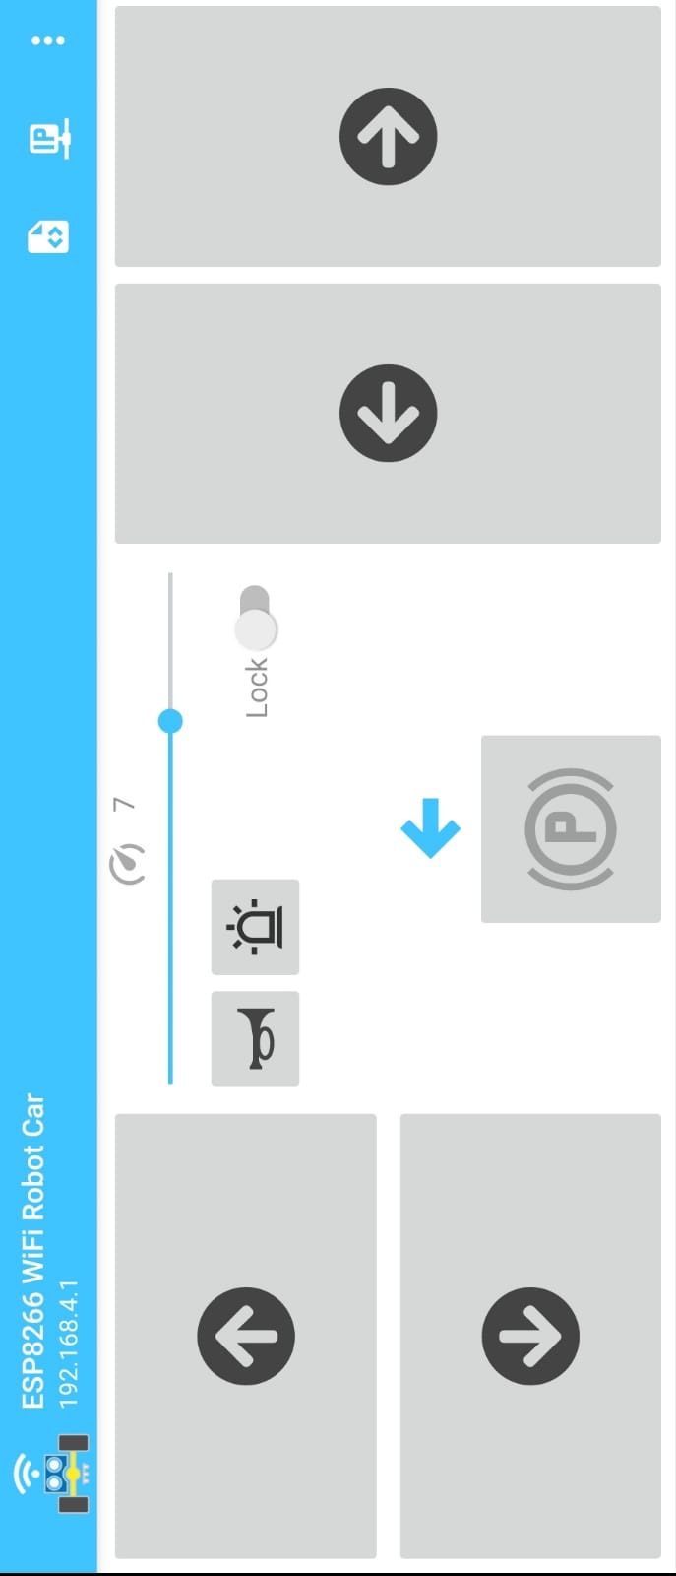
Android Application (ESP8266 WIFI Car)
Compatibility: The Android application is designed to run on Android smartphones and tablets. It is compatible with a wide range of Android versions to ensure accessibility for users.
User Interface: The Android application provides a user-friendly and intuitive interface. It typically consists of buttons, sliders, and other interactive elements that allow users to control the movement and functions of the robotic car.
Wireless Communication: The Android application communicates with the ESP8266 WIFI module via a wireless connection. It establishes a connection with the module using a specific network protocol or IP address, enabling real-time control and feedback.
Control Functions: The Android application offers various control functions to maneuver the robotic car. These may include forward, backward, left turn, right turn, stop, speed control, and other custom commands depending on the project implementation.
Customization and Additional Features: The Android application may allow users to customize certain aspects of the control interface, such as button layout, color schemes, or control sensitivity. It may also include additional features like video streaming from the car's camera or GPS tracking.

Slide 20
Advantages
Accessibility: User-friendly interface for easy operation.
Remote Control: Control the car from a distance using an Android device.
Real-Time Feedback: Instant information on position, sensor readings, and video streaming.
Versatility: Adaptability for various applications and industries.
Educational Value: Learning platform for robotics, wireless communication, and mobile app development.
Safety Enhancement: Obstacle detection and alcohol sensor for safer operation.
Innovation and Future Advancements: Promotes innovation and opens doors for future advancements.

Slide 21
Disadvantages
Dependency on Android Device: The project relies on an Android device for control, which may limit the accessibility for users who do not have compatible devices.
Connectivity Limitations: The range of the wireless connection between the Android device and the robotic car may be limited, restricting the operating distance.
Power Source: The project requires a stable power source, and the use of batteries may limit the operating time before recharging or replacing is needed.
Complexity: The integration of different components and technologies may make the project more complex, requiring advanced technical knowledge and skills for setup and troubleshooting.
Cost: Depending on the selected components and materials, the project may require a significant financial investment, making it less accessible for some individuals or organizations.

Slide 22
Safety Features
Obstacle Detection and Avoidance: The robotic car is equipped with an ultrasonic sensor that detects obstacles in its path. It utilizes this information to navigate and avoid collisions, enhancing safety during operation.
Alcohol Detection: The inclusion of an alcohol sensor allows the robotic car to detect alcohol concentration in the surrounding environment. This feature promotes responsible use and helps prevent accidents related to impaired driving.
Emergency Stop: A dedicated emergency stop button or mechanism is implemented to instantly halt the robotic car's movement in critical situations, prioritizing safety and preventing potential accidents.
Secure Wireless Communication: The project emphasizes secure wireless communication between the Android device and the robotic car, employing encryption protocols to prevent unauthorized access or control, ensuring the safety and privacy of the users.

Slide 23
Applications
Surveillance and Security: The Android-controlled robotic car can be utilized for surveillance purposes, patrolling areas and providing real-time video monitoring, making it useful for security applications.
Exploration and Mapping: The robotic car can navigate and explore environments that are difficult or unsafe for humans, collecting data and creating maps for various applications like disaster management, exploration of remote areas, or archaeological research.
Education and STEM Learning: The project can be used as an educational tool to teach robotics, programming, and wireless communication concepts. It can inspire students to explore the field of robotics and encourage interest in STEM (Science, Technology, Engineering, and Mathematics) subjects.
Entertainment and Gaming: The Android-controlled robotic car can be incorporated into gaming applications, allowing users to engage in interactive and immersive experiences by controlling the car through their smartphones or tablets.
Research and Development: The project serves as a platform for researchers and developers to experiment with different control algorithms, sensor integrations, and autonomous navigation techniques, advancing the field of robotics and autonomous vehicles.

Slide 24
Future Enhancements
Autonomous Navigation: Implementing advanced algorithms and sensors, such as computer vision and machine learning, can enable the robotic car to navigate autonomously, making intelligent decisions based on its surroundings.
Sensor Integration: Integrating additional sensors, such as temperature sensors, humidity sensors, or gas sensors, can expand the capabilities of the robotic car, allowing it to gather more environmental data and perform more complex tasks.
Gesture or Voice Control: Enhancing the control interface by incorporating gesture recognition or voice commands can provide alternative and intuitive ways to interact with the robotic car, improving the user experience.
Multi-Robot Collaboration: Developing a system where multiple robotic cars can communicate and collaborate with each other opens up possibilities for coordinated tasks and cooperative operations in various domains.
Augmented Reality Integration: Combining the robotic car with augmented reality technology can create interactive and immersive experiences, overlaying virtual objects or information onto the real-world environment.
Energy Efficiency: Exploring energy-efficient designs, optimizing power consumption, and utilizing renewable energy sources can extend the operating time of the robotic car and reduce its environmental impact.

Slide 25
Technical Challenges
Wireless communication stability
Motor control and precision
Sensor integration and calibration
Power management
Software development and debugging
Obstacle detection and avoidance

Slide 26
Results and Demonstration
Successful implementation of the Android-controlled robotic car
Remote control functionality demonstrated through the Android application
Smooth maneuvering of the car in different directions
Accurate obstacle detection and avoidance capabilities showcased
Reliable wireless communication between the Android device and the robotic car

Slide 27
Acknowledgments
Our project advisors and mentors for their guidance and support throughout the development process.
The faculty and staff of our institution for providing us with the necessary resources and facilities.
Our project team members for their dedication, hard work, and collaboration.
The open-source community for their valuable contributions and resources.
Our friends and family for their encouragement and support.

Slide 28

Thank You

